Slide 1
Biomimicry: Adapting Self-cooling Termite Mounds
Ananya Mantravadi
CS19B1004

Slide 2
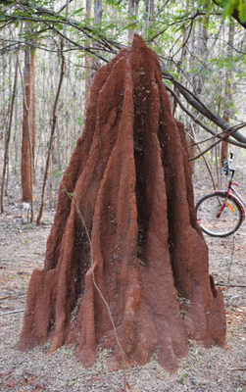
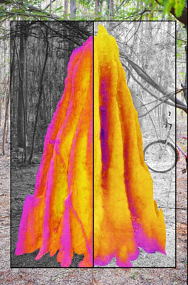
Ventilation in termite mounds
The temperature outside the mound keeps rising and falling. The termites have developed a method to harness that to ventilate their mounds.
Although these termite structures may look solid from the outside, they are actually covered in tiny pores that allow air to pass through freely, and like a giant lung, the structure inhales and exhales as temperatures oscillate.
The mechanism largely relies on the structure of the mounds themselves.
At night (left side) the flutes are cooler, so the air first moves down them and then up the central core. During the daytime (right), the warmer air reverses the process, moving air up the flutes and then down the central core. Occurring once a day, it allows CO2 from deep inside the mound to surface and diffuse through the porous walls. Thus the mound works like a slowly breathing lung, powered by daily temperature oscillations.

Slide 3
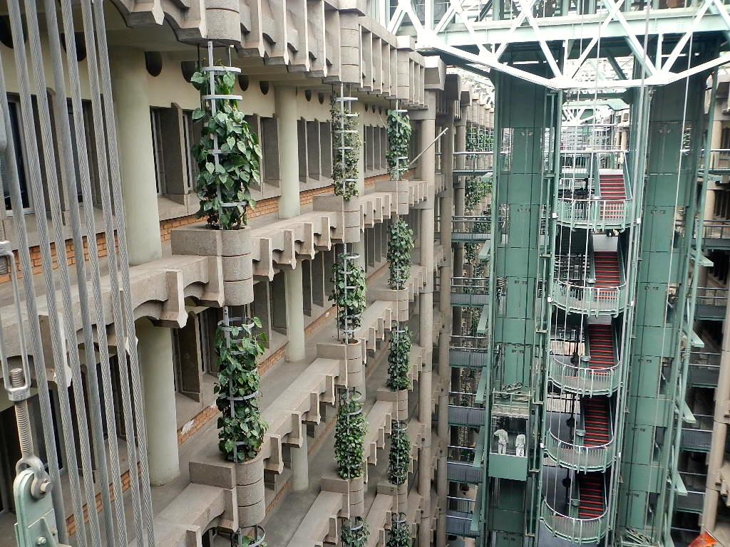
Mimicking and building self-cooling architecture
Inside the mound is an extensive system of tunnels and conduits that serves as a ventilation system for the underground nest. In order to get good ventilation, the termites construct several shafts leading down to the cellar located beneath the nest. They come in a wide variety of shapes and sizes. Some, like Odontotermes termites build open chimneys or vent holes into their mounds, while others build completely enclosed mounds like Macrotermes.
Similarly, if we could drive large-scale flows through a building through a designed model, it would be very beneficial in terms of energy saving.
This idea inspired to build The Eastgate Centre, which uses less than 10% of the energy of a conventional building its size.

Slide 4
References
https://news.harvard.edu/gazette/story/2015/09/how-termites-ventilate/
https://inhabitat.com/building-modelled-on-termites-eastgate-centre-in-zimbabwe/
https://en.wikipedia.org/wiki/Mound-building_termites
https://video.nationalgeographic.com/video/magazine/decoder/00000163-4f96-de63-afe7-7fdf708d0000

